Slide 1
Introduction to Machine Learning
Assignment 1

Slide 2
Assignment 1
Instructions
Submit all the solutions in a single file (Jupyter notebook (ipynb) file). Name your file with <roll number>_ML_Assignment1.ipynb. Example: 201501995_ML_Assignment1.ipynb
Do not copy from your friends or other web resources.
Due Date: 16 October 2022 11:59 PM
Submit within the deadline.

Slide 3
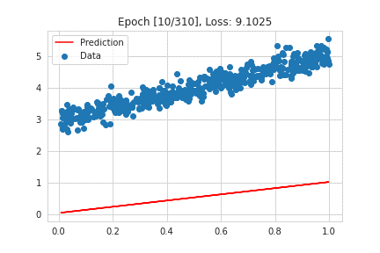
1. Linear Regression
Use the House Rent dataset given during the class.
a) Implement the simple linear regression from scratch. Use Rent as dependent feature and Size as independent feature. Split the dataset into training and testing. For each iteration during training, plot the linear regression line and corresponding loss in one graph. Compute R-squared error and mean-squared error for the test data. Your plot should look like as follows.

Slide 4
b) Multi-variate Linear Regression
Implement the multi-variate linear regression from scratch.
Use Rent as dependent feature and BHK, Size, Bathroom as independent features.
Split the dataset into training and testing. Plot the loss value in each iteration.
Compute R-squared error and mean-squared error for the test data.
Note: Do not use any libraries for coding (except for plotting and train_test_split)

Slide 5
2. Logistic Regression
Use the breast cancer dataset given during the class.
Implement the logistic regression from scratch to predict the given instance is whether Benign or Malignant.
Split the dataset into training and testing.
Plot the loss value in each iteration.
Compute the accuracy, precision, recall, and f-score for the test data.
Note: Do not use any libraries for coding (except for plotting and train_test_split)

